Slide 1
Color sorter
Group Members :
1605005
1605006
1605012

Slide 2
Short Description
A machine which can detect the color of an object and put it into the designated container of that color. The colors which will be detected are fixed in advance. It can be used to detect around 4 to 5 colors.

Slide 3
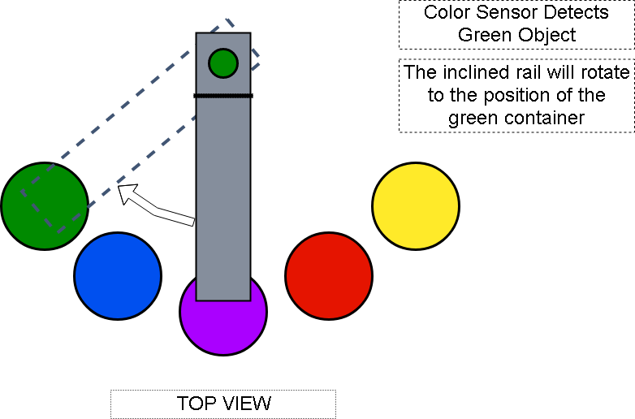

Slide 4
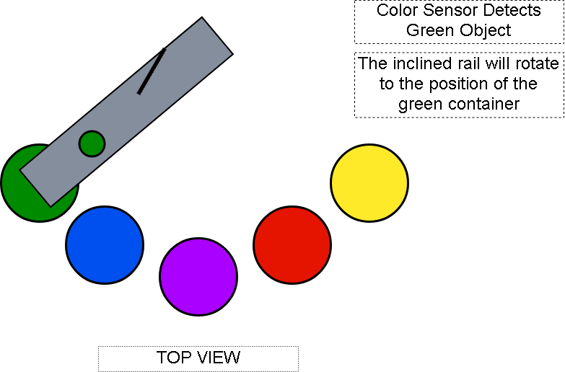

Slide 5
MOTIVATION
There are several industries that heavily rely on manpower to sort different types of raw materials after unpacking and output products before packaging. This consumes a lot of time, effort and money.
If we automate the process, it will save both time and human resources.
The accuracy obtained by a machine will be better than an average human.

Slide 6
Tentative list of instruments
TCS3200 RGB Color Sensor : 1 pc
- to detect color of the objects
Servo Motor SG90 : 2 pcs
- to maneuver the inclined rail
- to control the valve
ATMega32 : 1 pc
USBasp AVR Programmer : 1 pc
16×2 LCD Display : 1 pc
- to display the name of the color of the scanned object

Slide 7
Thank You
☺

